Slide 1
Problem Identification
Big Mountain Resort offers spectacular views with access to 105 trails. Every year about 350,000 people ski or snowboard at Big Mountain. Big Mountain Resort has recently installed an additional chair lift to help increase the distribution of visitors across the mountain.
This additional chair increases operating costs by $1,540,000 this season.
The resort's pricing strategy has been to charge a premium above the average price of resorts but there's a suspicion that Big Mountain is not capitalizing on its facilities as much as it could.
What opportunities exists for Big Mountain resort to rework their cost structure to absorb the $1.54M investment in a new chair lift?

Slide 2
Recommendations and Key Findings
Increased pricing would not reduce traffic to the resort.
Permanently closing down up to 10 of the least used runs. This doesn't impact any other resort statistics.
Increase the vertical drop by adding a run to a point 150 feet lower down but requiring the installation of an additional chair lift to bring skiers back up, without additional snow making coverage.
Increasing snowmaking area would be unadvised due to cost. Big Mountain already has some of the most snowmaking area in the market.

Slide 3
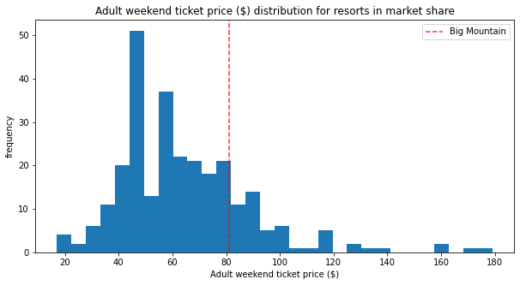
Pricing Analysis
Increase Price: Big Mountain Resort modelled price is $95.87, actual price is $81.00. Even with a possible error margin of $10.39, this suggests there is room for an increase for at least $5/ticket with no other improvements.
Improving the facilities would justify further increases to ticket price.

Slide 4
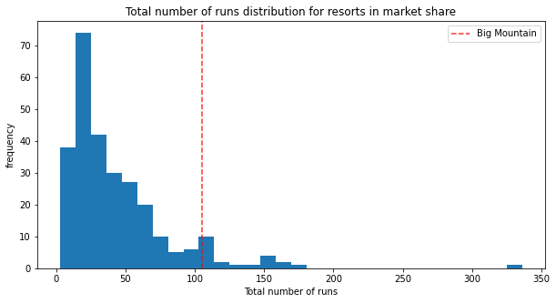
Reducing Costs: Permanently closing down up to 10 of the least used runs
Big Mountain has a significantly higher amount of runs than the majority of the market. Closing down 10 rarely used runs shouldn’t significantly impact the customer experience.

Slide 5
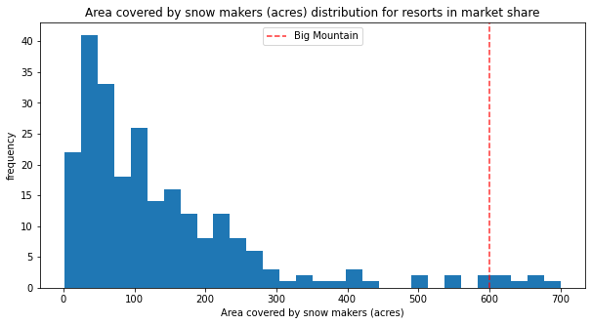
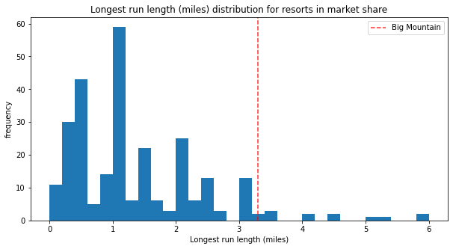
Improving Customer Experience: Increase Vertical Drop
Increase the vertical drop by adding a run to a point 150 feet lower down but requiring the installation of an additional chair lift to bring skiers back up. Snow coverage is above average which should allow us to do this without increasing snowmaking.
This would make Big Mountain the highest vertical drop in the Market!

Slide 6
Conclusion
After considering the options we recommend implementing the following:
Increase the price somewhere between $5-15/person.
Permanently close down runs: up to 10 of the least used runs.
Increase the vertical drop by adding a run to a point 150 feet lower down

